Slide 1
Clicker 1
What is output by the following code?
ArrayList<Integer> a1 = new ArrayList<>();
ArrayList<Integer> a2 = new ArrayList<>();
a1.add(12);
a2.add(12);
System.out.println(a1 == a2);
false
true
No output due to syntax error
No output due to runtime error
Varies from one run of the program to the next
CS314
Linked Lists

Slide 2
Dynamic Data Structures
Dynamic data structures
  They grow and shrink one element at a time, normally without some of the inefficiencies of arrays
  as opposed to a static container such as an array
Big O of Array Manipulations
  Access the kth element
  Add or delete an element in the middle of the array while maintaining relative order
  adding element at the end of array? space avail? no space avail?
  add element at beginning of an array
CS314
Linked Lists

Slide 3
Object References
Recall that an object reference is a variable that stores the address of an object
A reference can also be called a pointer
They are often depicted graphically:
student
John Smith
40725
3.57
CS314
Linked Lists

Slide 4
References as Links
Object references can be used to create links between objects
Suppose a Student class contained a reference to another Student object
John Smith
40725
3.57
Jane Jones
58821
3.72
CS314
Linked Lists

Slide 5
References as Links
References can be used to create a variety of linked structures, such as a linked list:
studentList
CS314
Linked Lists

Slide 6
Linked Lists
A linear collection of self-referential objects, called nodes, connected by other links
  linear: for every node in the list, there is one and only one node that precedes it (except for possibly the first node, which may have no predecessor,) and there is one and only one node that succeeds it, (except for possibly the last node, which may have no successor)
  self-referential: a node that has the ability to refer to another node of the same type, or even to refer to itself
  node: contains data of any type, including a reference to another node of the same data type, or to nodes of different data types
  Usually a list will have a beginning and an end; the first element in the list is accessed by a reference to that class, and the last node in the list will have a reference that is set to null
CS314
Linked Lists

Slide 7
Advantages of linked lists
Linked lists are dynamic, they can grow or shrink as necessary
Linked lists are non-contiguous; the logical sequence of items in the structure is decoupled from any physical ordering in memory
CS314
Linked Lists

Slide 8
Nodes and Lists
A different way of implementing a list
Each element of a Linked List is a separate Node object.
Each Node tracks a single piece of data plus a reference (pointer) to the next
Create a new Node very time we add something to the List
Remove nodes when item removed from list and allow garbage collector to reclaim that memory
CS314
Linked Lists

Slide 9
A Node Class
public class Node<E> {
private E myData;
private Node<E> myNext;
public Node()
{ myData = null; myNext = null; }
public Node(E data, Node<E> next)
{ myData = data; myNext = next; }
public E getData()
{ return myData; }
public Node<E> getNext()
{ return myNext; }
public void setData(E data)
{ myData = data; }
public void setNext(Node<E> next)
{ myNext = next; }
}
CS314
Linked Lists

Slide 10
One Implementation of a Linked List
The Nodes show on the previous slide are singly linked
  a node refers only to the next node in the structure
  it is also possible to have doubly linked nodes.
  The node has a reference to the next node in the structure and the previous node in the structure as well
How is the end of the list indicated
  myNext = null for last node
  a separate dummy node class / object
CS314
Linked Lists

Slide 11
A Linked List Implementation
public class LinkedList<E> implements IList<E>
private Node<E> head;
private Node<E> tail;
private int size;
public LinkedList(){
head = null;
tail = null;
size = 0;
}
}
LinkedList<String> list = new LinkedList<String>();
LinkedList
myHead iMySize
myTail
null
0
null
CS314
Linked Lists

Slide 12


Writing Methods
When trying to code methods for Linked Lists draw pictures!
  If you don't draw pictures of what you are trying to do it is very easy to make mistakes!
CS314
Linked Lists

Slide 13
add method
add to the end of list
special case if empty
steps on following slides
public void add(E obj)
CS314
Linked Lists

Slide 14
Add Element - List Empty (Before)
head tail size
null
null
0
Object
item
CS314
Linked Lists

Slide 15
Add Element - List Empty (After)
head tail size
1
Node
myData myNext
String
null
CS314
Linked Lists

Slide 16
Add Element - List Not Empty (Before)
head tail size
1
Node
myData myNext
null
String
String
item
CS314
Linked Lists

Slide 17
Add Element - List Not Empty (After)
head tail size
2
Node
myData myNext
Node
myData myNext
null
String
String
CS314
Linked Lists

Slide 18
Code for default add
public void add(E obj)
CS314
Linked Lists

Slide 19
Clicker 2
What is the worst case Big O for adding to the end of an array based list and our LinkedList314 class? The lists already contain N items.
Array based Linked
O(1) O(1)
O(N) O(N)
O(logN) O(1)
O(1) O(N)
O(N) O(1)

Slide 20
Contains method
Implement a contains method for our Linked List class
public boolean contains(E val) // val != null
CS314
Linked Lists

Slide 21
Code for addFront
add to front of list
public void addFront(E obj)
How does this compare to adding at the front of an array based list?
CS314
Linked Lists

Slide 22
Clicker 3
What is the Big O for adding to the front of an array based list and a linked list? The lists already contain N items.
Array based Linked
O(1) O(1)
O(N) O(1)
O(logN) O(1)
O(1) O(N)
O(N) O(N)
CS314
Linked Lists

Slide 23

Code for Insert
public void insert(int pos, E obj)
Must be careful not to break the chain!
Where do we need to go?
Special cases?
CS314
Linked Lists

Slide 24
Clicker 4
What is the Big O for inserting an element into the middle of an array based list and into the middle of a linked list? Each list already contains N items.
Array based Linked
O(1) O(1)
O(1) O(N)
O(N) O(1)
O(N) O(N)
O(N) O(logN)
CS314
Linked Lists

Slide 25
Clicker Question 5
What is the Big O for getting an element based on position from an array based list and from a linked list? Each list contains N items. In other words E get(int pos)
Array based Linked
O(1) O(1)
O(1) O(N)
O(N) O(1)
O(logN ) O(N)
O(N) O(N)
Linked Lists

Slide 26

Code for get
public E get(int pos)
The downside of Linked Lists
CS314
Linked Lists

Slide 27
Code for remove
public E remove(int pos)
CS314
Linked Lists

Slide 28
Clicker 6
What is the order to remove the last element of a singly linked list with references to the first and last nodes of the linked structure of nodes?
The list contains N elements
O(1)
O(logN)
O(N^0.5)
O(N)
O(NlogN))
CS314
Linked Lists

Slide 29
Why Use Linked List
What operations with a Linked List faster than the version from ArrayList?
CS314
Linked Lists

Slide 30
Clicker 7 - Getting All Elements in Order From a Linked List
What is the Order (Big O) of the following code?
LinkedList314<Integer> list;
list = new LinkedList314<Integer>();
// code to fill list with N elements
int total = 0;
//Big O of following code?
for(int i = 0; i < list.size(); i++)
total += list.get(i);
O(N) B. O(2^{N}) C. O(NlogN)
D. O(N²) E. O(N³)
CS314
Linked Lists

Slide 31
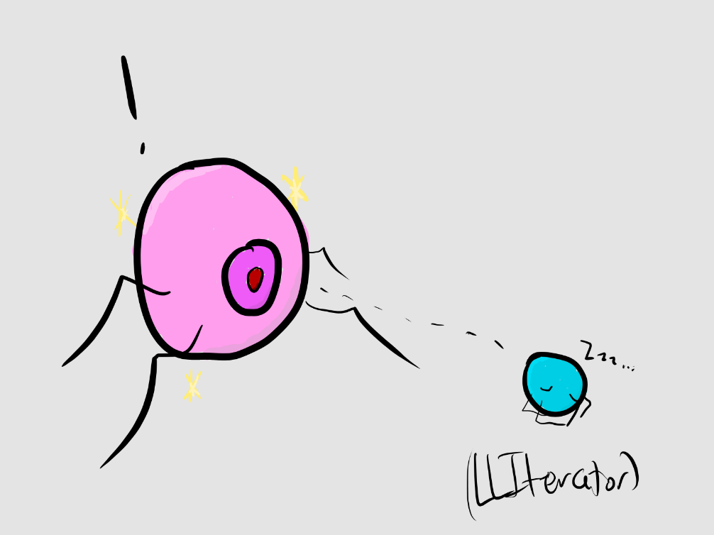
Iterators to the Rescue
CS314
Linked Lists

Slide 32
Other Possible Features of Linked Lists
Doubly Linked
Circular
Dummy Nodes for first and last node in list
public class DLNode<E> {
private E myData;
private DLNode<E> myNext;
private DLNode<E> myPrevious;
}
CS314
Linked Lists

Slide 33
Dummy Nodes
Use of Dummy Nodes for a Doubly Linked List removes most special cases
Also could make the Double Linked List circular
CS314
Linked Lists

Slide 34
Doubly Linked List add
public void add(E obj)
CS314
Linked Lists

Slide 35
Insert for Doubly Linked List
public void insert(int pos, E obj)
CS314
Linked Lists

